Slide 1

Year One Phonics Screening Check
Parent Workshop
10 June, 2015

Slide 2
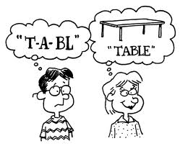
Phonics at St Monica’s in the EYFS and KS1
Children have 20-minute daily discrete phonics lessons.
Children are taught to read by breaking down words into separate sounds or ‘phonemes’. They are then taught how to blend these sounds together to read the whole word.
There are around 40 different sounds.

Slide 3
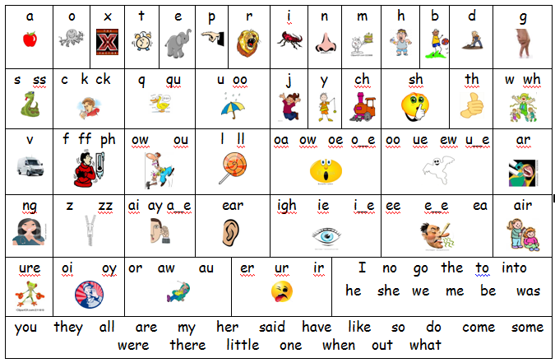

Slide 4
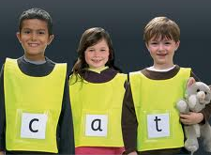
What is the Year One Phonics Screening Check?
Year 1children throughout England take the statutory phonics screening check during a DfE-designated week every June.
The check is very similar to activities the children do during their daily phonics lessons, orally segmenting and blending words.
The focus of the screening is to provide evidence of children’s decoding and blending skills.

Slide 5

What will the children do?
Each check will take 4 to 9 minutes to complete.
They will be asked to ‘sound out’ a word and blend the sounds together. e.g. d-o-g – dog
The check consists of 40 words and non-words;
Children will be told if the word is a real or ‘alien’ word, which will have a corresponding alien image.

Slide 6
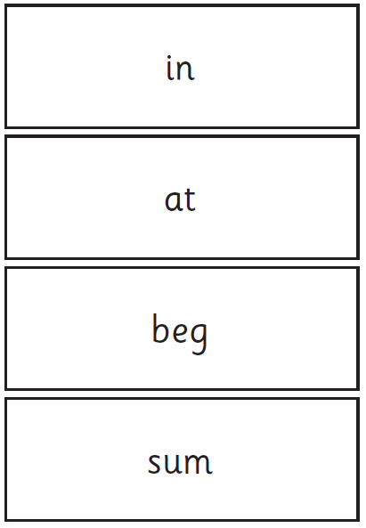
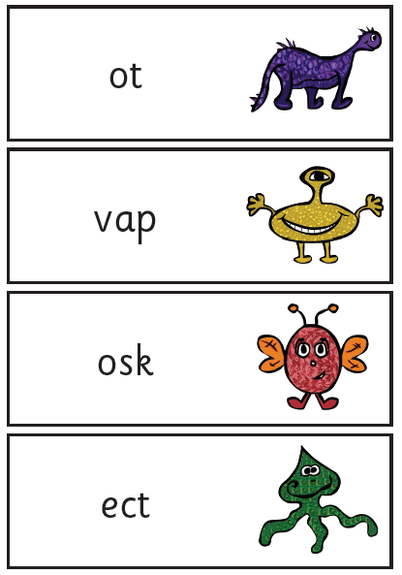
Examples of Words

Slide 7
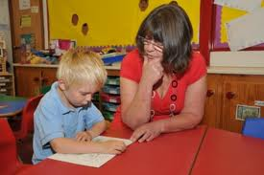
How is it administered?
Miss Caldicott conducts all screenings;
The children complete the check one to one in a quiet area;
We are not permitted to indicate at the time whether they have correctly sounded out and / or blended the word.

Slide 8

The results?
The children will be scored against a national standard (threshold yet to be published by DfE)
We will inform you of whether your child’s score fell below or within this standard.
If your child’s score falls below the national standard they can re-take the Phonics Screening Check in year 2.

Slide 9

When will it happen?
The screening will take place throughout the week beginning Monday 15th June.
It has been designed so that children of all abilities will be able to take part.

Slide 10

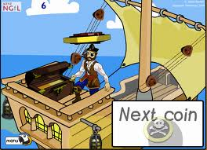

How can you help?
Encourage your children to use their sounds and actions to find the sound they need to read and write at home.
Children can practise their phonics by playing games online.
The children particularly like:
* Buried Treasure
* Poopdeck Pirates
* Picnic on Pluto

Slide 11


How else can you help?
REMEMBER: Phonics is not the only way your child can become a good reader. Continue to read with your child each night and encourage them to:
Sound out, re-read to check it makes sense, and use pictures for clues.
Ask them questions about the book;
And most importantly ENJOY READING!

Slide 12

Questions?

