Slide 1
Behaviour Policy Addendum
The behaviour Policy will be reviewed this academic year (2024-2025), we will be using the TGMC approach.
All resources shown have been saved in favourites on the TGMC website.

Slide 2
St. Monica’s Behaviour 24 -2 5

Slide 3
This year we will be using behaviour pathways to teach behaviour skills.
The idea is that we support children with their behaviour by teaching them the behaviours in small manageable steps.
This academic year we will focus on: Teamwork, Positive Communication and Resilience (more on this during September INSET). These will be displayed on the Behaviour Pathway.
Achievement assemblies will be called EMBRACE assembly.
Certificates will be given out for children who are showing ‘EMBRACE’ qualities.
Class Dojo will be for communication.

Slide 4
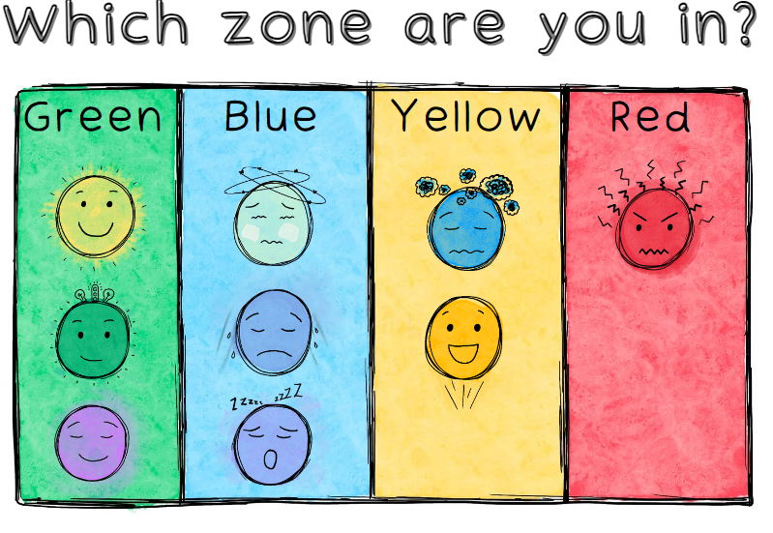
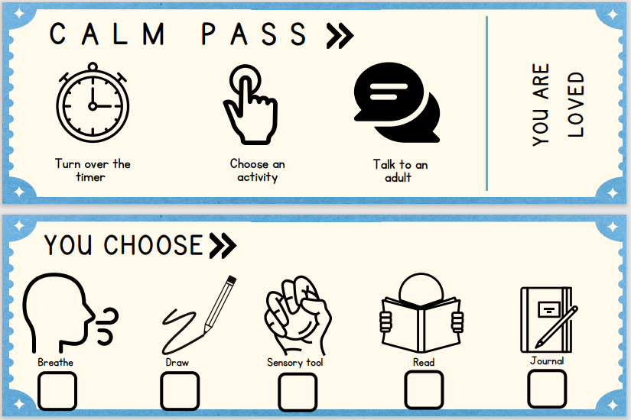
What do you need in class?
A behaviour pathway (shared in September)
A calm area
Zones Poster
Calm Pass
Sensory/activity box
Timer

Slide 5
TGMC – Reflection sheets
To be completed after incidents by children.

Slide 6
Class Dojo
Main use of Class Dojo will be for Parent communication.
Rewards:
Share children’s good work and behaviour skills with parents through pictures and recordings.
Sanctions:
Avoid removing dojos from children, rather the calm area and regular teacher check ins should be used to support undesirable behaviour.

Slide 7
TGMC
We have already started implementing some routines and strategies, such as:
Partner talk (Joshina)
Journaling at transition times (Ricky)
Task don’t ask (Ana Rita)
New for September:
Behaviour Pathways (Staff INSET 3rd September)

Slide 8
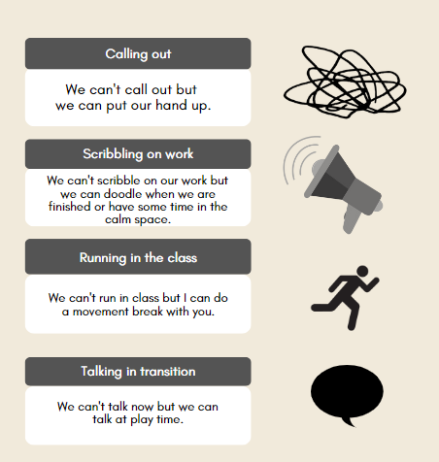
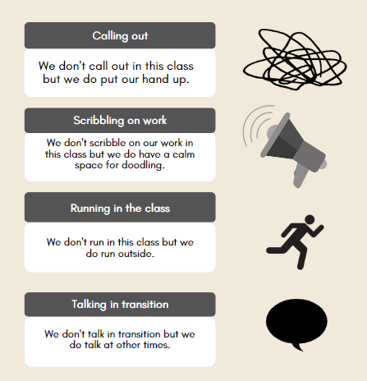
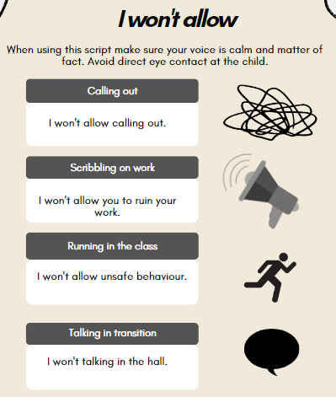
TGMC classroom scripts

Slide 9
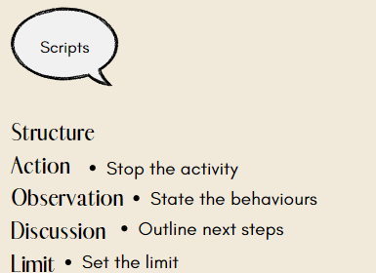
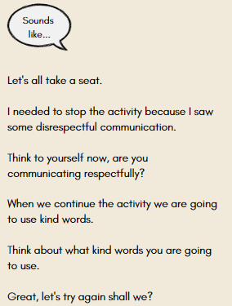
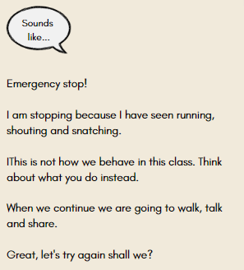
TGMC – Resetting expectations

Slide 10
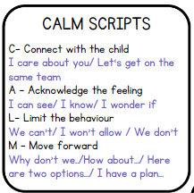
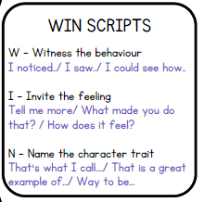
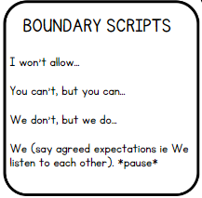
TGMC – Lanyard scripts

Slide 11
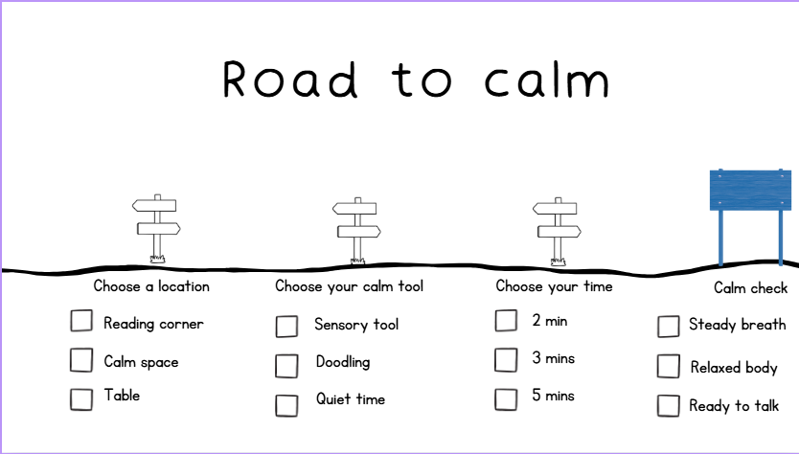
1:1 behaviour pathway. This supports children on their own journey to complete task or behaviour expected.

Slide 12
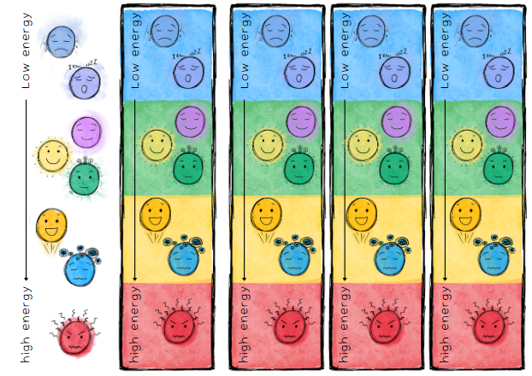
TGMC – Desktop check-ins

Slide 13
Pathways
Resources have been handed out
Break down into steps
Focus on positive behaviours not the negative behaviours
ALL partners (class) are accountable

Slide 14
Pathways
TEACH IT
Book
Drama
Reflection
Video

Slide 15
Pathways
TIP Framework
Tell
Identify skill
Practise new skill

Slide 16
Pathways
Children to succeed
Pathway not to be used more than two weeks
Bespoke to class
Move pointer closer to target
Collaboration vs competition
Class is a Team

